Slide 1

Four Seasons Hotel Database Management System
Muhammad Hassan : FA21-BCE-051

Slide 2
Outline
Introduction
Literature Review
Proposed Solution
Results
Learning
Conclusion

Slide 3

Introduction
Four Seasons Hotels strategically located in major cities - Islamabad, Lahore, Karachi, Faisalabad, Multan, and Peshawar.
Necessitates a resilient Database Management System (DBMS) for seamless orchestration of day-to-day activities.
Envisioned DBMS to monitor room statuses, intricate booking details, comprehensive guest information, and detailed employee records.
Focus on archival data of check-in records across all branches for thorough historical tracking.

Slide 4

Literature Review
Distinctive Demands of Four Seasons Hotels:
Unique operational requirements, including coordination across multiple branches.
Meticulous archival of historical guest records, necessitating a specialized approach.
Tailored Database Management System (DBMS):
Recognition of the need for a customized solution for Four Seasons Hotels.
Beyond conventional features, the system aims to address specific operational challenges.
Enhanced Operational Efficiency:
Optimization of database management to elevate customer experience.
Focus on improving operational efficiency through tailored solutions for seamless coordination.
Key Functionalities:
Room status monitoring, booking management, and guest information storage as foundational features.
Emphasis on unique aspects like historical record archiving and multi-branch operations coordination.

Slide 5

Proposed Solution
Tailored Approach: Customized Database Management System (DBMS) required for Four Seasons Hotels to meet distinctive requisites.
Conventional Functionalities: Monitoring room statuses, efficient booking management, guest information storage, and streamlined employee administration are basic features.
Unique Challenges: Mandate for seamless multi-branch coordination and meticulous archival of historical guest records set Four Seasons Hotels apart.
Augmenting Efficiency: The primary goal is to enhance customer experience and operational efficiency through a precisely crafted, be spoke solution.

Slide 6

Normalization
Normalization Importance: Central to the DBMS design for Four Seasons Hotels, normalization aims to eliminate data redundancy and dependency while optimizing overall database architecture.
Adherence to Principles: The design steadfastly adheres to normalization principles, ensuring efficient data organization, mitigating anomalies, and improving system performance.
Decomposition Process: Substantial tables are decomposed into more manageable, interconnected tables, emphasizing the use of foreign keys for unification.
Visual Transformation: Accompanying figures visually demonstrate the transformation, highlighting the improved structure for a coherent and effective data storage system.

Slide 7
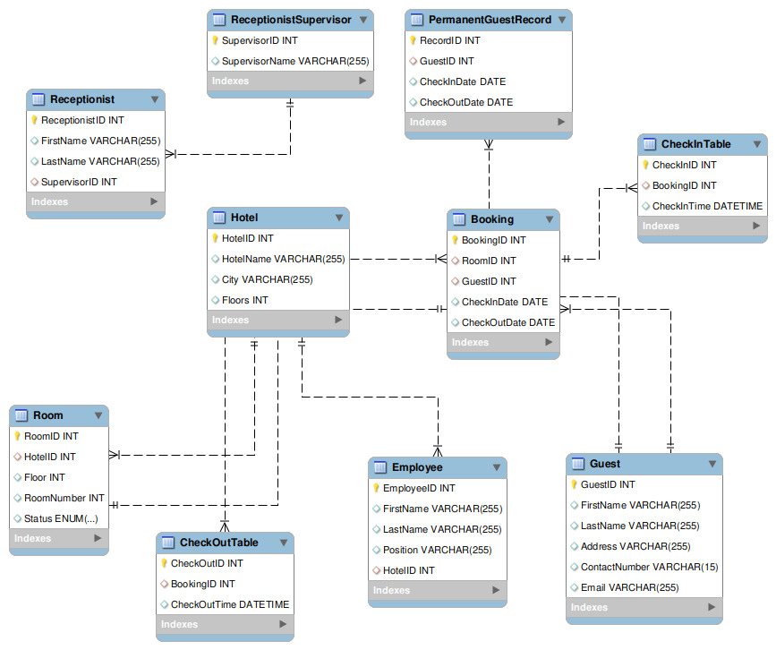
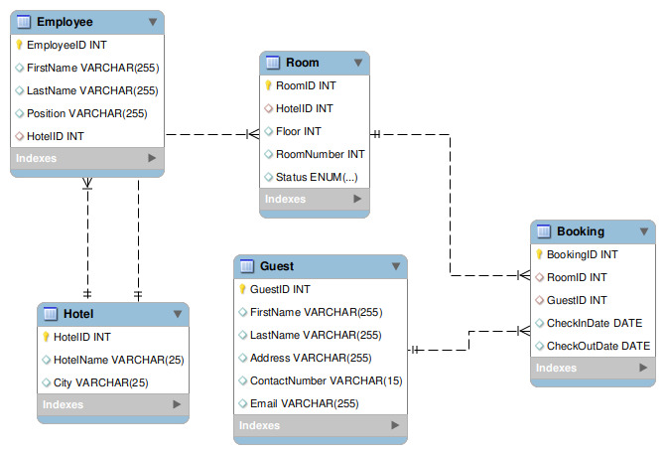
Before
After

Slide 8

Learning
Continuous Learning Culture:
Fostering an environment where individuals and organizations are committed to ongoing learning and development.
Adaptive Learning Strategies:
Embracing versatile approaches to learning that cater to diverse needs, preferences, and evolving educational technologies.
Personalized Learning Paths:
Tailoring learning experiences to the individual needs and goals of learners, acknowledging diverse learning styles and paces.
Data-Driven Learning Analytics:
Utilizing insights from learning analytics to inform decision-making, enhance educational strategies, and measure the effectiveness of learning initiatives.

Slide 9
Conclusion
Holistic Solution for Multi-Branch Management:
The DBMS for Four Seasons Hotels is a comprehensive solution tailored to manage the challenges of a multi-branch hotel chain.
Normalization-Centric Design:
The methodical database design, centered around Third Normal Form (3NF), aims at ensuring data consistency, minimizing redundancy, and optimizing overall system performance.
Crucial Functionalities:
Encompassing real-time room status tracking, detailed booking information, comprehensive guest profiles, employee records, and meticulous historical data management, the system meets intricate hospitality sector demands.
Commitment to Excellence:
The DBMS emphasizes continuous improvement, adaptability to industry trends, and a user-friendly interface, promising a substantial impact on operational efficiency and service excellence for Four Seasons Hotels.

Slide 10

Thank you so much Any Question

